Slide 1
Chapter 1: Introduction to Systems Analysis and Design

Slide 2
CS 682 Not a programming course Focused on concepts and applications Eclectic vocabulary, definitions key Building block approach Will follow text Case studies
Notes:
READ SLIDE

Slide 3
Name
Background / bio
Likes / dislikes / hobbies
Their Dream Job
“take away” from 682
Notes:
Team up in pairs. Introduce the person next to you.

Slide 4
Syllabus
CS 682: Systems Analysis and Design Methods
Text:
Systems Analysis and Design: An Object-Oriented Approach with UML 5th Edition
by Alan Dennis, Barbara Haley Wixom, and David Tegarden
Publisher: Wiley; 5 edition ISBN-10: 1118804678 ISBN-13: 978-1118804674
Instructor:
Angelo Guadagno
Phone: 617-266-1028 (evening)
Cell: 617-283-6680)
Email: angelo0527 @ gmail.com
Email: angelog1 @ bu.edu
Availability:
Normally I am available during business hours at 617-283-6680 (cell). If not, you can leave a voice message or contact me via email.
Notes:
Best bet is to contact me is :
1) Email (personal or BU)
2) My cell 617-283-6680
Bio & Describe Assertive

Slide 5
Course Objectives
This course is designed to enable you to:
Discriminate among types of business systems
Explain and summarize a proposed systems analysis project
Assess and critique the issues of working in a team
Distinguish between system-level and low-level requirements
Distinguish between architectural and detailed designs
Rank the goals of good system design
Understand UML models
Notes:
At the end of the course you should be able to:
Both understand & design quality systems using Object Oriented technology
Participate comfortably in most roles of an Information Technology project

Slide 6
One (1) course, Three (3) sections
Three (3) Websites
The nature of the E1 Section dictates:
Similar but different
Assignments
Quizzes, Final
Discussions
Notes:
The message here is if you are not on the appropriate web site you will be in trouble
If you ask assignment, quiz or discussion questions to students in the other sections you will not get the correct information

Slide 7
Focus:
The focus of the class will be to interactively discuss contemporary issues and methods of systems analysis and design. The methodology will include lecture, group discussion, on line discussion, and presentation of your team project (In Class Section) The assumption is that each student brings professional experience and background which contributes to the analysis and discussion of the material.
Notes:
The message here is the less you actively participate. The longer / less interesting the class will be!

Slide 8
The grade for the course is determined by the following: (In Class Section)
Requirements Paper 10%
Project Proposal 15%
Mid Term Exam 25%
Final Exam 35%
Participation 5%
Presentations (2@5 each) 10%
Study Questions (Optional) 05%
Notes:
Since you will receive the answers to all homework assignments on the
day they are do, NO late assignments will be accepted
Note the sum equals 110%. For bonus work I will assign 10 to 15 short questions to be answered & handed in. If all your answers are all correct, your grade can increase by one full letter. If all your answers are incorrect, your grade score remains unaffected. If your answers are somewhere in between, your grade score will increase accordingly. All optional written homework assignments are to be handed in, in hard copy, before the beginning of class on the day there are due. No email or electronic submissions will be graded.

Slide 9
The grade for the course is determined by the following: (Blend Section)
Weekly Assignments /
Class Attendance 20%
Final Exam 30%
Quizzes 20%
Discussions 30%
Notes:
Since you will receive the answers to all homework assignments on the
day they are do, NO late assignments will be accepted

Slide 10
Weekly Overview
Each week you will need to: (In Class Section)
Review lectures slides
Read assigned pages in the textbook
Participate fully in the discussion topics.
Complete the homework assignment (optional)
Work on your project.
Notes:
You will be expected to:
Read the assigned chapter & outside material
Participate in discussions
Complete your Group Project
Do your non optional homework

Slide 11
Weekly Overview
Each week you will need to: (Blend Section)
Read the online lectures
Read assigned pages in the textbook
Participate fully in the discussion topics. This includes submitting your own comments and reading submissions from other students.
Complete the homework assignment(s)
Notes:
You will be expected to:
Read the assigned chapter & outside material
Participate in discussions
Do your homework
Each student must participate in at least three (3) discussions per week (six (6) discussion postings per module) to demonstrate an understanding of the material, ask questions he / she might have, share related thoughts the material catalyzes,

Slide 12
Assignment Notes: (Blended Section)
Each week of this course starts on a
Wednesday.
Discussions should start no later than Monday of each week.
Discussions and written assignments are all due each week by Thursday at 6:00 AM ET.
University or other holidays do not affect these due dates.
Notes:
Your magic day is Thursday!

Slide 13
Typical Module
Week #1 & #2-
Course Readings:
Online lectures Dennis, Wixom & Tegarden, pages x –y
Discussions:
Discussion 1 postings due week #3 at 6:00 AM
Assignment:
Assignment 1 due week #3 at 6:00 AM
Quiz:
Quiz 1 due week #3 at 6:00 AM
Notes:
You will have to plan your week well & manage your time equally well.
Falling behind or procrastination dig holes that are hard to climb out of

Slide 14
Project Assignment (In Class Sections)
Each student will select a business problem or opportunity that requires an automation, reengineering or other computerized system solution. Your solution will include a review and analysis of all the related business process and workflows that might be impacted. Your solution must demonstrate that you have addressed the root cause of the problem or why the opportunity was ignored rather than its related symptoms.
Notes:
Focus on new internal systems that represent a total redesign of an existing system or an internal system that is being built with an intent of increasing enterprise efficiency by lowering internal costs or increasing revenue

Slide 15
Project Assignment (In Class Sections)
Your selection should be something you are familiar with and reflective of an end user scenario vs. an OEM or developing a system for resale. Or vs. a startup / new venture with no history of expenses or revenues.
Technology upgrades that do not include a great deal of input from all its users will also not be suitable.
Notes:
No one builds a system with a reason. And that reason has to have some level of justification. So projects that include little actual user involvement or a system for resale or technology upgrades are not acceptable.

Slide 16
Project Assignment (In Class Sections)
The project requires your team to be either employees of or consultants to the enterprise that will benefit from the project and the project owner is in place before your first presentation. In addition, your team has been notified that your project is competing with other enterprise projects for the limited funds available.
Notes:
Every system has an “owner” or a “sponsor. An information system’s sponsor is the business executive who champions the system throughout the enterprise and is responsible for funding the project. He or she insures the required internal resources are applied to the project, defines the project’s scope, sets the acceptance criterion and approves each phase of the project

Slide 17
Each team will present (using Microsoft PowerPoint or equivalent) their first presentation to the class on a date assigned to you. On the day of the presentation, each student will submit a copy of their presentation with presentation notes.
Notes:
Hard copy of both your Power Point presentation and its associated paper are to be handed in before you begin and must also be emailed to the class TA
On week #3, each team will submit a one (1) paragraph description of your end user project as you would to your supervisor in the real world. Please make sure you read the syllabus in depth BEFORE you choose a project & submit this paragraph. Your will receive a note back from me with comments & either a “go” or “needs revision”
Your first presentation is an executive summary. As I said, it is note to your supervisor asking his/her for input & a “go ahead” on what you are thinking of doing. You will be expected to include the tools & concepts listed in your text to present an acceptable summary.
If you want a “head start” you can email it to me anytime or submit it earlier than week #3.

Slide 18
The second presentation focuses on the “to be” system – what it will do, what it will consist of and how it will be built.
Notes:
This presentation will also restate your executive summary (which may be altered based on management feedback from your first

Slide 19
Presentation #2 will also include a detailed alternatives matrix with a minimum of 3 distinctly different options detailing how the “to be” system might be built.
Building the entire system in house,
Outsourcing the project
Purchasing an existing system
Purchasing components
Notes:
Presentation #2 will also include a detailed alternatives matrix with a minimum of 3 distinctly different options detailing how the “to be” system might be built. These options can include but are not limited to building the entire system in house, outsourcing the build of the entire system, purchasing a system from vendor A & integrating it, purchasing a system from vendor B & integrating it, purchasing components of the system & completing the build in house, etc.

Slide 20
Other requirements include a
Fully populated alternatives matrix
A minimum of 3 distinctly different build options
Scores & weights
Notes:
Other requirements include a fully populated alternatives matrix listing a minimum of 3 distinctly different build options with their respective scores & weights. Please refer to the text and the first few class presentation slides in Chapter Six (6) for additional information

Slide 21
The presentations & papers associated with the semester project have several, very specific requirements.
Please read, understand and adhere to all the requirements detailed in the Class Syllabus and the Class Presentation Slides for Chapter 6
Notes:
The presentations & papers associated with the semester project have several, very specific requirements.
Please read, understand and adhere to all the requirements detailed in the Class Syllabus and the Class Presentation Slides for Chapter 6

Slide 22
Learning Objectives
Systems development life cycle
Identify the four phases
How it came about
Methodology alternatives
Team roles & skill sets
Object-oriented systems characteristics
Object-oriented systems analysis & design
The Unified Process & its extensions
The Unified Modeling Language (UML)
Notes:
When you are tasked with something that has a defined measure of success, is large, complex, includes a large cast of characters with diverse backgrounds & objectives and requires unique skill sets, What are some of the tings you have to worry about?

Slide 23
Systems Development Life Cycle (SDLC)
Planning
Analysis
Design
Implementation
Notes:
Why do we need a formal process for Information for Information Technology (IT) Systems?
Most organizations employ a systematic process known as a system approach to solve their problems. The SDLC is the approach that is most commonly used to solve IT type problems or develop information solutions. It is sometimes is referred to as “Information Systems Development” or “Application Development.”
The SDLC is a process that consists of four phases and each phase consists of a series of steps
What does each phase of the SDLC have in common?
What is the core concept of this systems approach?
Who is responsible for this process?
Can these phases overlap one another?
Must we complete a phase before we begin the next step?
Can we cycle back to a previously completed step?
What does gradual refinement mean in context of SDLC?

Slide 24
Questions to be Answered
Planning phase
Analysis phase
Design phase
Implementation phase
Notes:
What questions should be answered during the planning phase?
What questions should be answered during the analysis phase?
What questions should be answered during the design phase?
What questions should be answered during the implementation phase?

Slide 25
Assume you are a systems analyst who will be responsible to the owner of a small brick & mortar retail store for a point of sale system.
Where or from whom will you get the information required to complete the planning and analysis phases of your project?

Slide 26
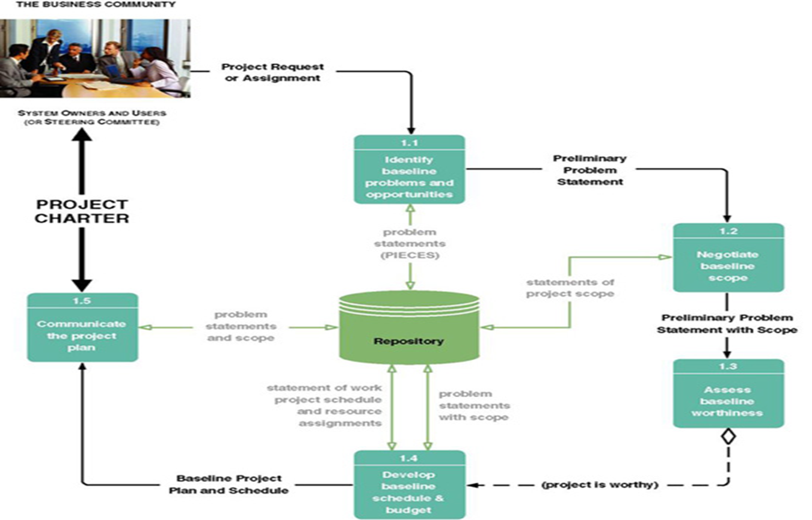
Notes:
The planning phase is the first phase of the classical systems development process. What questions do we ask in this phase?
This slide is called a task diagram for a phase. What does it show?
Are the tasks outlined on the slide universal to all projects?

Slide 27

Notes:
One of the tools used during the initial scope phase of a project by some companies is a formal document to request services. Does your company use this approach?
Does it look like this sample?
What is the role of a project sponsor?
What is the role of the approval committee?

Slide 28
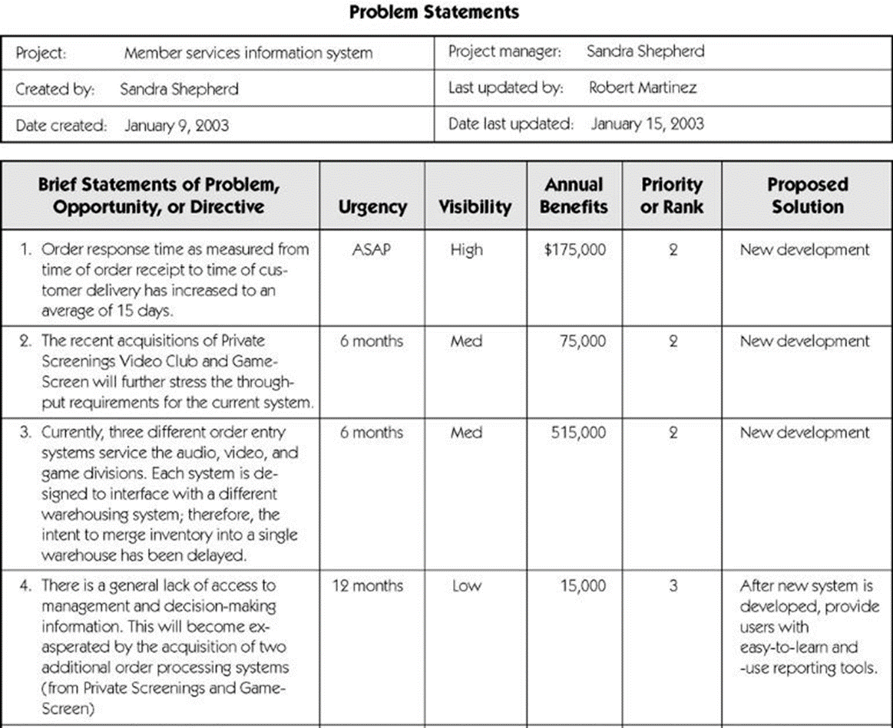
Notes:
At the beginning of each project the reason for the project i.e. the problem to be solved should be documented in a memo, report or some formal format form. Does everyone understand the example?

Slide 29
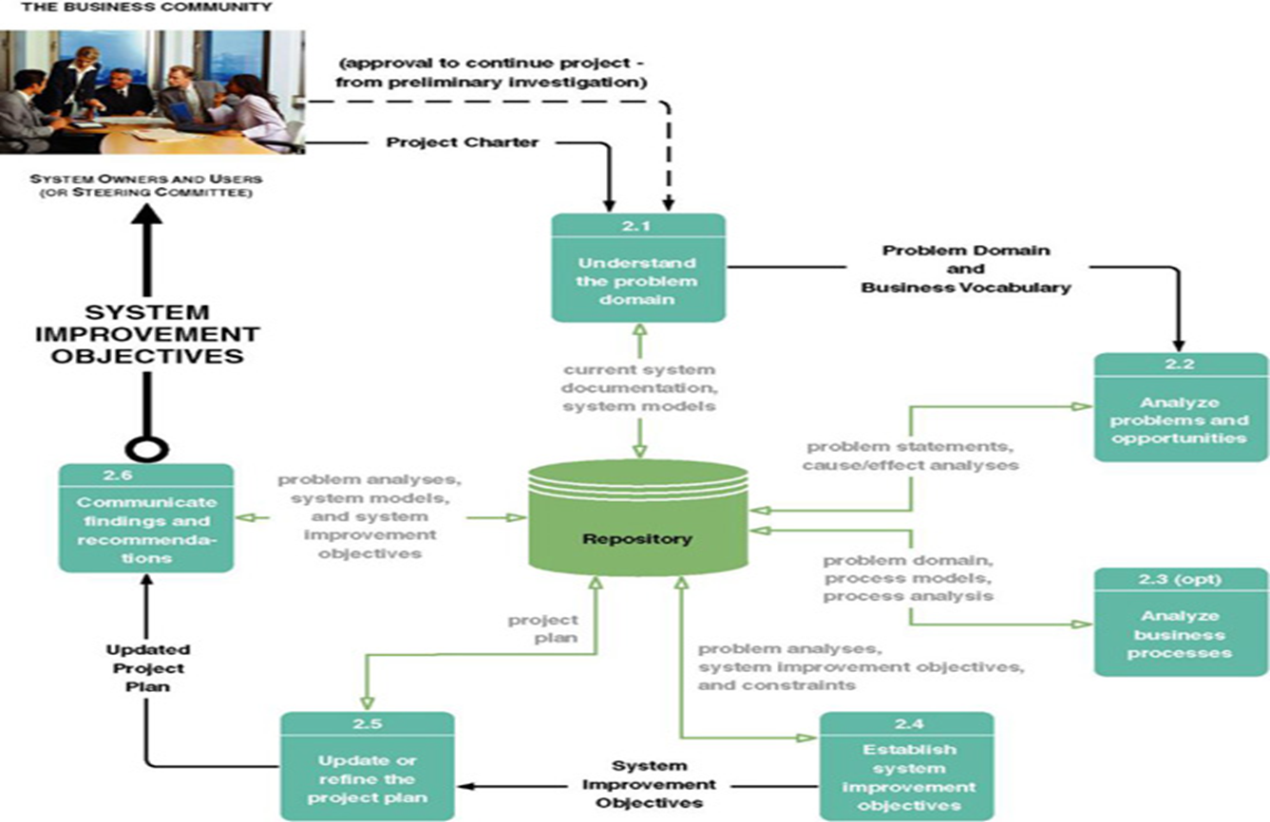
Notes:
What does the dashed line at the top of the diagram represent?
What is the deliverable from this phase?
Remember during this phase we are still focused on what the new system will do not how we will do it. What happens if you skip this phase?
What milestone is achieved during this phase?
Are all these tasks sequential?

Slide 30
You are a new systems analyst and eager to prove your abilities on your first project. You are at a problem analysis meeting with the system owner and users and find yourself saying, “We need to do this to solve the problem.” Into what trap are you falling?

Slide 31
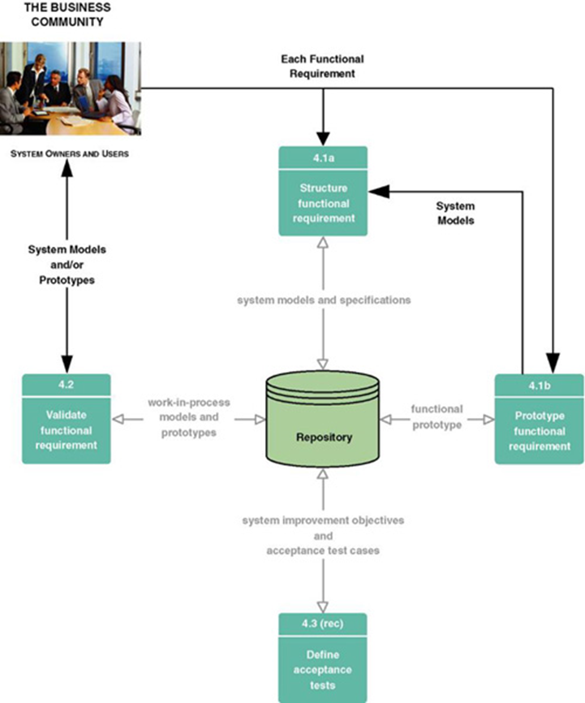
Notes:
After we determine what the users need we focus on the drawing of the various system models to document the requirements for a new & improved system. What is the output of this phase?

Slide 32
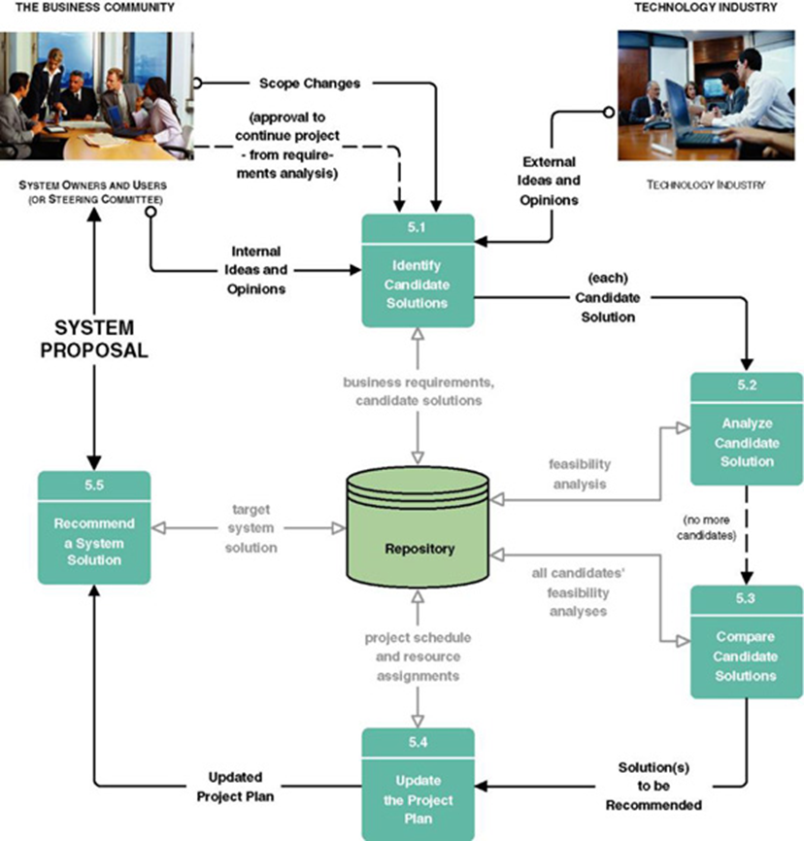
Notes:
During this phase we want to identify candidate solutions, analyze those solutions and recommend a target system that will be designed, constructed & implemented. What is the outcome of this phase?
What transitions are going on during this phase?

Slide 33
SDLC: Methodologies
Methodologies have been developed
Methodology: a formalized approach to implementing the SDLC
Categories
Process oriented
Data centered
Object-oriented
Structured
Rapid action development
Agile development
Notes:
In terms of software development what is a methodology?
System development methodologies have been around a long time and even some “oldies” like structured analysis & design are still used. What is common among newer methodologies?
Methodologies have been developed by the government and have formal standards, others have been developed by consulting firms for resale to clients and still others have been developed & honed internally by some enterprises. Are methodologies categorized?

Slide 34
Why do companies use methodologies?

Slide 35
What does gradual refinement mean in context of SDLC?

Slide 36
Why do many choose to purchase methodology?

Slide 37
What is the role of a project sponsor?

Slide 38
What is the role of the approval committee?

Slide 39
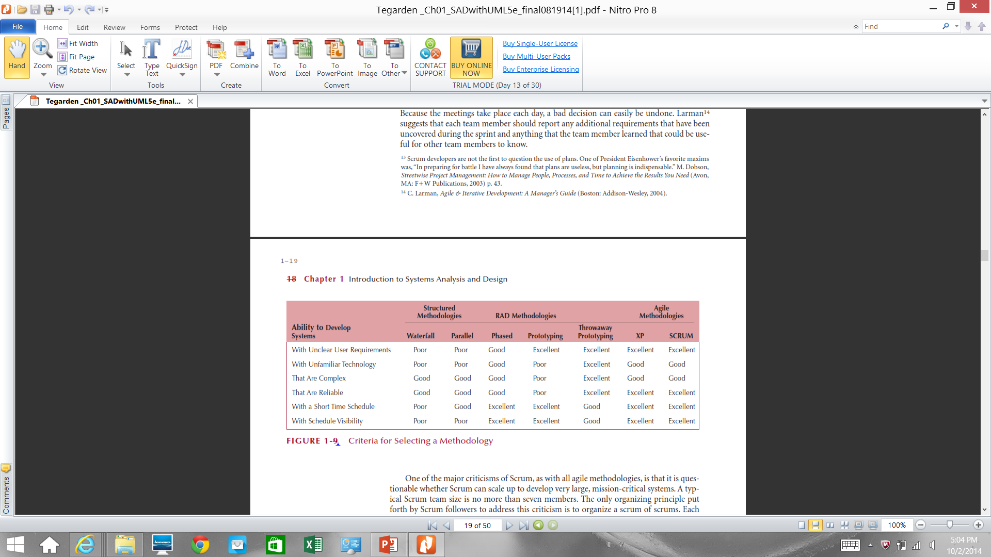
Which Methodology to Use?
Notes:
What is Structured Design?
What is Waterfall development?
What are the advantages of a waterfall methodology?
What are the disadvantages of a waterfall methodology?
What is a parallel methodology?
What are Rapid Application Development Methodologies?
What is a Phased Development Methodology?
What are the advantages of a Phased Approach?
What is a Prototyping Based Methodology?
What are the disadvantages of a Prototyping Based Methodology?
What is Agile Development?
What are some of the disadvantages of Agile Development?
What is a Scrum Methodology?
How do you select a methodology?
Can you mix & match methodologies?

Slide 40
The Systems Analyst: Skills
Agents of change
Identify ways to improve the organization
Motivate & train others
Skills needed:
Technical: must understand the technology
Business: must know the business processes
Analytical: must be able to solve problems
Communications: technical & non-technical audiences
Interpersonal: leadership & management
Ethics: deal fairly and protect confidential information
Notes:
What is systems analysis?
What are some other names for a systems analyst?
What does the systems analyst really do?
Do System Analysts “sell anything”?
Why does the SA need to have business knowledge?
Have any of you had experience as or with SA’s? Or a customer of a systems analysis solution?

Slide 41
1. Thou shalt not use a computer to harm other people.
2. Thou shalt not interfere with other people’s computer work.
3. Thou shalt not snoop around in other people’s computer files.
4. Thou shalt not use a computer to steal.
5. Thou shalt not use a computer to bear false witness.
6. Thou shalt not copy or use proprietary software for which you have not paid.
7. Thou shalt not use other people’s computer resources without authorization or proper compensation.
8. Thou shalt not appropriate other people’s intellectual output.
9. Thou shalt think about the social consequences of the program you are writing or the system you are designing.
10. Thou shalt always use a computer in ways that insure consideration and respect for your fellow human
Notes:
How do you know if someone is ethical?
Note from the slide that ethics also applies to intellectual output.

Slide 42
The Systems Analyst: Roles
Business Analyst
Focuses on the business issues
Systems Analyst
Focuses on the IS issues
Infrastructure Analyst
Focuses on the technical issues
Change Management Analyst
Focuses on the people and management issues
Project Manager
Ensures that the project is completed on time and within budget
Notes:
Are we talking about 6 different people?
Where do Business analysts come from?

Slide 43
The Systems Analyst: Roles
Business Analyst
Focuses on the business issues
Systems Analyst
Focuses on the IS issues
Infrastructure Analyst
Focuses on the technical issues
Change Management Analyst
Focuses on the people and management issues
Project Manager
Ensures that the project is completed on time and within budget
Notes:
We said a System Analyst is an agent of change. In that capacity what are some of functions he or she must provide / capacities he / she must have?

Slide 44
Developing an information system is similar to building a house because you have to
a. start with a basic idea of what is needed
b. create simple drawings of what is needed and allow the customer to provide feedback
c. develop a detailed set of blueprints
d. actually build the project, often with some changes directed by the customer
e. all of the above

Slide 45
The analysis phase of the SDLC answers which questions _____.
a. who will create the system and when will it be used
b. who will the system be for, what the system will do, when will it be used, and where will it be used
c. why build the system, what the system will be, and how the system will work
d. why build the system, who will the system be for, when will it be used, and how the system will work
e. why build the system, who will the system be for, when will it be used, and where will it be used
Ans: b

Slide 46
In which phase of the SDLC is the system specification developed?
a. analysis
b. design
c. implementation
d. planning
e. system delivery

Slide 47
Briefly summarize the purpose of the analysis phase in SDLC. Explain why it exists and what it contributes to the completion of the system.

Slide 48
The planning phase is the fundamental process of understanding how an information system should be built and determining who on the project team will build it.
True / False ?

Slide 49
Why do we need a formal process for Information for Information Technology (IT) Systems?

Slide 50
What does each phase of the SDLC have in common?

Slide 51
What is the core concept of the SDLC approach?

Slide 52
What questions should be answered during the planning phase?

Slide 53
What questions should be answered during the analysis phase?

Slide 54
In terms of software development what is a methodology?

Slide 55
What is systems analysis?

Slide 56
Why does the SA need to have business knowledge?

Slide 57
What is Structured Design?

Slide 58
What is Waterfall development?

Slide 59
What are the advantages of a waterfall methodology?

Slide 60
What are the disadvantages of a waterfall methodology?

Slide 61
What is a parallel methodology?

Slide 62
What are Rapid Application Development Methodologies?

Slide 63
What is a Phased Development Methodology?

Slide 64
What are the advantages of a Phased Approach?

Slide 65
What is a Prototyping Based Methodology?

Slide 66
What are the disadvantages of a Prototyping Based Methodology?

Slide 67
What is Agile Development?

Slide 68
What are some of the disadvantages of Agile Development?

Slide 69
What is a Scrum Methodology?

Slide 70
Object-Oriented Systems Analysis & Design
Attempts to balance data and process
Utilizes the Unified Modeling Language (UML) and the Unified Process
Characteristics of OOAD:
Use-case Driven
Architecture Centric
Iterative and Incremental
Notes:
What does “balance data & process mean? Focus the decomposition of problems on objects that contain both data and process
What is a use case? Describes how the user interacts with the system to perform some activity

Slide 71
Characteristics of Object-Oriented Systems
Classes & Objects
Object (instance): instantiation of a class
Attributes: information that describes the class
State: describes its values and relationships at a point in time
Methods & Messages
Methods: the behavior of a class
Messages: information sent to an object to trigger a method (procedure call)
Notes:
What is the difference between classes and objects? Classes are blue prints objects are the instantiation of the class
What is a method or behavior? Methods implement an objects behavior
What are messages? The information sent to objects to trigger the methods (effectively objects talking to other objects)

Slide 72
Characteristics of Object-Oriented Systems (cont.)
Encapsulation & information hiding
Encapsulation: combination of process & data
Information hiding: functionality is hidden
Inheritance
General classes are created (superclasses)
Subclasses can inherit data and methods from a superclass
Notes:
Why are encapsulation and information hiding important characteristics of object-oriented systems?
What is Inheritance?
What is the difference between a Concrete Class & an Abstract Class?

Slide 73
Characteristics of Object-Oriented Systems (cont.)
Polymorphism & dynamic binding
Polymorphism: the same message can have different meanings
Dynamic binding: type of object is not determined until run-time
Contrast with static binding
Notes:
If an object sends a “compute pay” message to two objects. One receiver object computes the pay for hourly employees & the other for salaried employees & the appropriate object responds, which of the 3 objects is exhibiting polymorphism?
What is the difference using the “compute pay” scenario between dynamic & static binding?
What is dynamic binding?

Slide 74
Object-Oriented Systems Analysis & Design
Use-case driven
Use-cases define the behavior of a system
Each use-case focuses on one business process
Architecture centric
Functional (external) view: focuses on the user’s perspective
Static (structural) view: focuses on attributes, methods, classes & relationships
Dynamic (behavioral) view: focuses on messages between classes and resulting behaviors
Notes:
What does use case driven mean?
What does architecture centric mean?

Slide 75
Object-Oriented Systems Analysis & Design
Use-case driven
Use-cases define the behavior of a system
Each use-case focuses on one business process
Architecture centric
Functional (external) view: focuses on the user’s perspective
Static (structural) view: focuses on attributes, methods, classes & relationships
Dynamic (behavioral) view: focuses on messages between classes and resulting behaviors
Notes:
What are the benefits of Object-Oriented Systems Analysis & Design?

Slide 76
The Unified Process
A specific methodology that maps out when and how to use the various UML techniques for object-oriented analysis and design
A two-dimensional process consisting of phases and workflows
Phases are time periods in development
Workflows are the tasks that occur in each phase
Activities in both phases & workflows will overlap
Notes:
Briefly describe the Unified Process (UP).

Slide 77
Unified Process Phases
Inception
Feasibility analyses performed
Workflows vary but focus is on business modeling & requirements gathering
Elaboration
Heavy focus on analysis & design
Other workflows may be included
Construction: Focus on programming (implementation)
Transition--Focus on testing & deployment
Notes:
When we say “workflows” what activities we are actually engaging in?

Slide 78
Extensions to the Unified Process
The Unified Process does not include:
Staffing
Budgeting
Contract management
Maintenance
Operations
Support
Cross- or inter-project issues
Notes:
What is not included in the Unified Process?
What was done to address these omissions?

Slide 79
Unified Modeling Language
Provides a common vocabulary of object-oriented terms and diagramming techniques rich enough to model any systems development project from analysis through implementation
Version 2.5 has 15 diagrams in 2 major groups:
Structure diagrams
Behavior diagrams
Notes:
Is there anyone “in charge” of UML?
What is the primary purpose of structure diagrams?
Give some examples of structure diagrams.
What are behavior diagrams used for?
Give some examples of behavior diagrams

Slide 80
Which following is one of the basic characters of object-oriented systems :
a. process
b. data
c. module
d. inheritance
e. garbage collection

Slide 81
Polymorphism is made possible through ________________ :
a. static binding
b. dynamic binding
c. initialization
d. messaging
e. Information hiding

Slide 82
Explain the idea of prototyping and indicate when prototyping is appropriate.

Slide 83
Agile development is considered a special case of RAD approach to developing systems.
True / False?

Slide 84
A local retailer has hired Geneva and Sydney to develop his new information system. He is not sure what type of system he wants, but it must be completed in four months and he needs to know regularly that the project is on schedule. Geneva and Sydney should use the Waterfall Development methodology for constructing the system.
True / False?

Slide 85
Briefly describe the benefits of Object-Oriented Systems Analysis and Design (OOSAD)

Slide 86
In the UML, the Use Case Diagram is an example of structure diagram.
True / False?

Slide 87
An object is same as its class since both have attributes and behaviors.
True / False ?

Slide 88
What does “balance data & process mean?

Slide 89
What is a use case?

Slide 90
What does use case driven mean?

Slide 91
What is the difference between classes and objects?

Slide 92
What are methods or behaviors?

Slide 93
What are messages?

Slide 94
What is the difference between a Concrete Class & an Abstract Class?

Slide 95
Why are encapsulation and information hiding important characteristics of object-oriented systems?

Slide 96
When we say “workflows” what activities we are actually engaging in?

Slide 97
Briefly describe the Unified Process (UP).

Slide 98
What is not included in the Unified Process?

Slide 99
What is the primary purpose of structure diagrams?

Slide 100
What are behavior diagrams used for?

Slide 101
Read Mini Case #1
Page #39 in the Text

Slide 102
How do you respond to Barbara’s complaint?

Slide 103
Read Mini case #3
Page #40 in the Text

Slide 104
How do you convince Jack to move forward using an Object-Oriented systems development method?

Slide 105
Mini Case
Read
(Class Handout)

Slide 106
What type of information system is RightNow’s eService Center, a TPS, MIS, DSS, or some other specialized system?
Present the rationale for your answer

Slide 107
Besides cost savings, what other benefits does the eService Center provide for the upper-level managers of MyFamily.com?

Slide 108
The types of questions that this automated system assists customers with are described as typical customer inquiries. Do you think handling frequently asked questions (FAQs) is a job better suited for man or machine? Why?

Slide 109
Mini Case
Read
(Class Handout)

Slide 110
How do the major problems at Acme manifest themselves?
What are some of the root causes of Acme’s problems?
Develop a strategy for increasing intranet usage across Acme
What additional elements would a “broad knowledge management strategy” require?
How would Stein address the cultural aspect of knowledge management?

Slide 111
How do the major problems at Acme manifest themselves?

Slide 112
What are some of the root causes of Acme’s problems?

Slide 113
Develop a strategy for increasing intranet usage across Acme

Slide 114
What additional elements would a “broad knowledge management strategy” require?

Slide 115
How would Stein address the cultural aspect of knowledge management?

